Slide 1

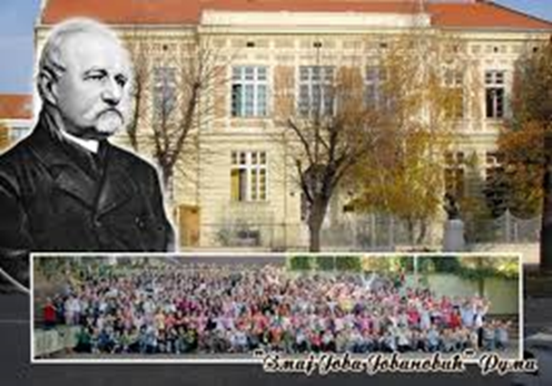


Primary School ’Zmaj Jova Jovanović’ Ruma, Serbia
FROM BORING TO EXCITING
Copy the text below and paste it on the title and/or copyright page of your print work or presentation, or in the credits of your media.

Slide 2
In our school we use every oportunity to turn studying of boring things into an interesting event. Sometimes, it’s an activity in eTwinnig project, sometimes that means organizing a Science Fair, where peeer learning and fun take place.

Slide 3
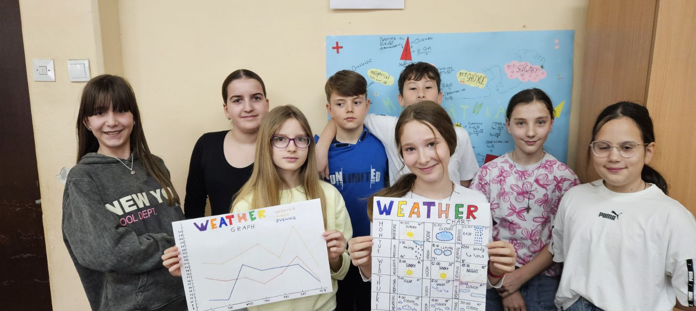
eTwinnig projects
Studying graphs through an eTwinning project

Slide 4
Sometimes regular classes can be very interesting,too. For example

Slide 5
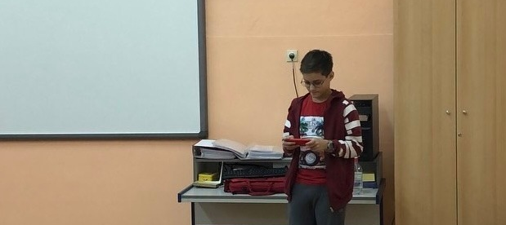
ICT classes
are always much more interesting when operating with robots and drons.

Slide 6
Maths At the Science Fair,mathematical models created by the students were presented.The Pythagoras tree was made to help students understand the meaning of the Pythagorean theorem. Models of Platonic solids were also made: the tetrahedron, the hexahedron (cube), the octahedron, the icosahedron, and the dodecahedron. A large mind map illustrated the learning of mathematical areas throughout primary school, while on individual maps the students demonstrated their knowledge of Similarity and Divisibility. There was also a section where a city, surrounded by trees, represented the large number of formulas that students learn during primary school.

Slide 7
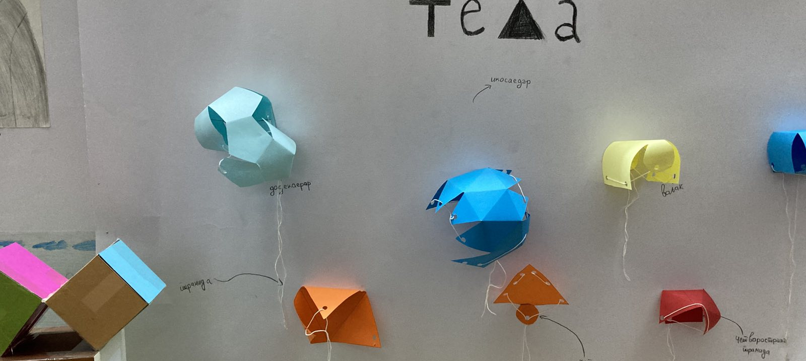
Mathematical models
Made by students

Slide 8
Physics: Many phenomena and processes in the field of physics can often be demonstrated with devices that are quickly constructed from materials commonly found in every household. This way, introducing students to some basic natural phenomena and processes is reduced to constructing and performing simple experiments. During the Science Fair, we showed in an engaging way how we can use baking soda and vinegar to inflate a rubber balloon, or how science can help us take a coin out of a plate filled with water without getting our hands wet. The students also made a water carousel and explained the application of Newton’s third law—the law of action and reaction.

Slide 9
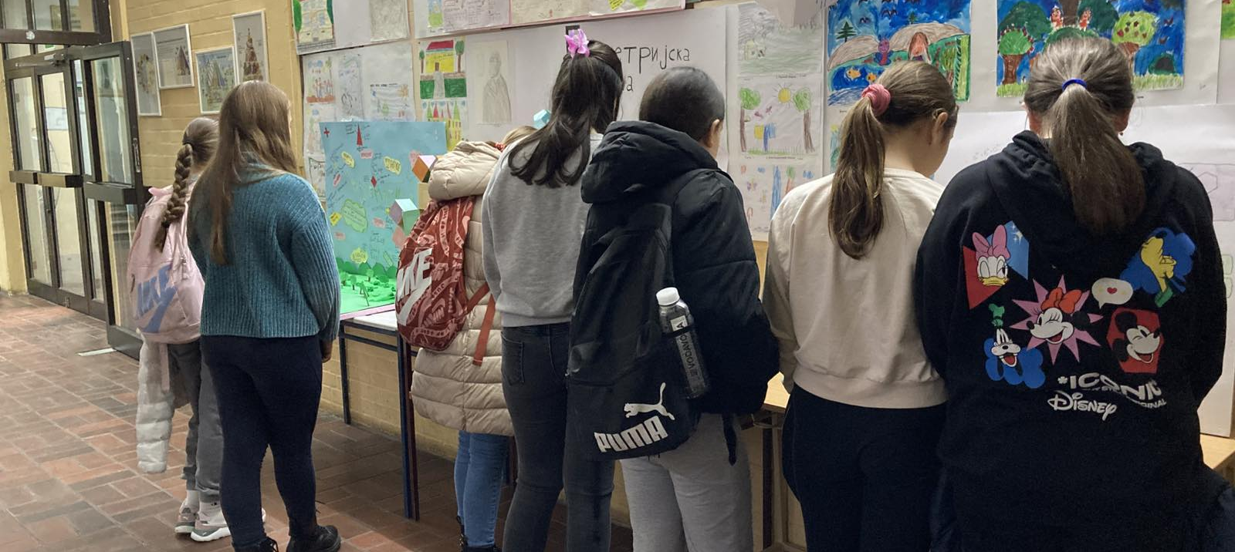
Exibition of students’ works
was set in the school’s hall

Slide 10
The most interesting part for them was when they placed two forks on top of a toothpick so that they stood still, proving the conditions of equilibrium. They managed, with the help of a vacuum, to attach two glasses together, as well as to put a boiled egg into an empty bottle, thereby demonstrating the intensity of atmospheric pressure. With the help of science, they also succeeded in separating mixed pepper from salt. And they even pulled off a few mathematical tricks using Möbius strips.

Slide 11
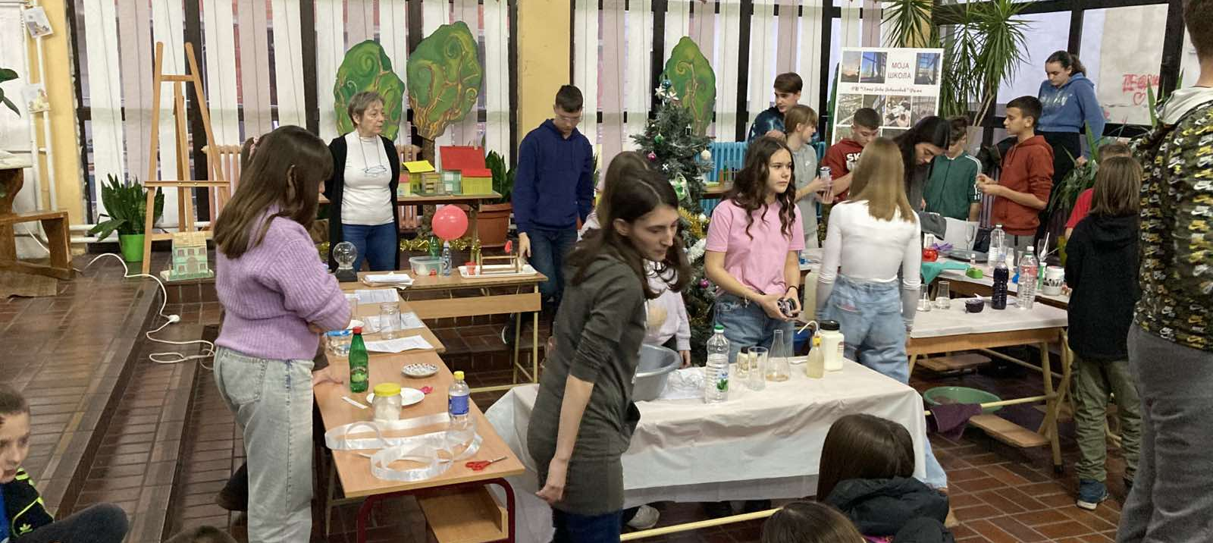
Experiments
and peer learning

Slide 12
Chemistry For children, chemistry is generally difficult and even unappealing. But at the Science Fair, the students conducted experiments mostly related to acids and bases, where they observed that some substances change color depending on whether the solution is acidic or basic. The experiments were effective, and the students were thrilled. They were amazed to discover that even vegetables can serve as indicators, such as red cabbage, and thus concluded that chemistry does not only involve dangerous and unknown substances, but that ordinary things can also be used as chemicals. They concluded that not everything is chemistry, but chemistry is all around us.

Slide 13
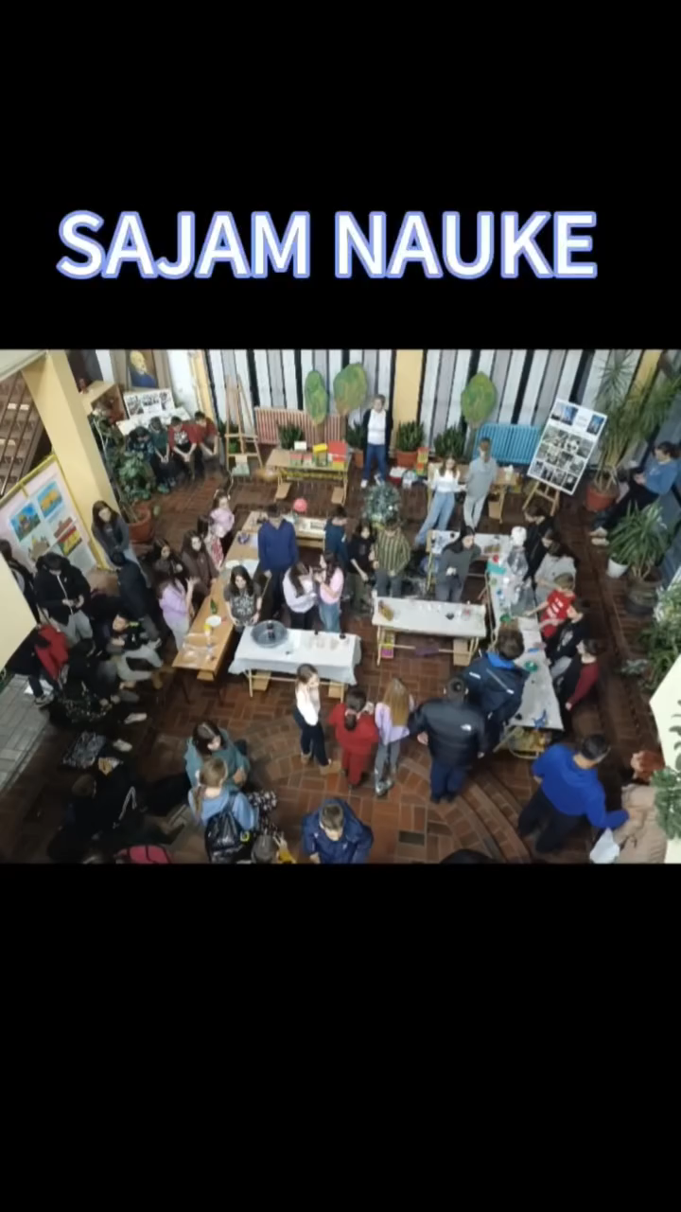

Science Fair
Funded by the European Union. Views and opinions expressed are however those of the author(s) only and do not necessarily reflect those of the European Union or the European Education and Culture Executive Agency (EACEA). Neither the European Union nor EACEA can be held responsible for them.

